Slide 1
Game Design Document
(option + Template Game)
Due: March 21th (Friday) @ Midnight

Slide 2
The design document should have the following components in it.
List of features (Enemies, power-ups, resources, puzzles etc.) that are going to be implemented using your game
List of all game objects and their sprites, sounds
Game play
  forms of (strategic) decision making
  forms of resource management
  balance between the different features
  who is in control
  variation, long-lasting appeal
AI
  behavior of the opponents and/or units
  quality of the motion planning
Description of the user interface and concept art.
Storyboard for the entire game from start to finish
Concept/pixel art for main game objects (player, enemies etc).
Breakdown of goals/objectives per level
Difficulty graph from start to end of the game, how
each level ramps up the difficulty using the various game-play elements
Hierarchy charts that show the inheritance between various parent child objects
Excel spread sheet that lists the timeline of completing the various tasks by last day of the class

Slide 3
Some guidelines while creating a design document
Use a top-down or side view rather than an isometric view.
For role-playing games, make the battles turn-based in a separate screen (e.g. like Pokemon) rather than real-time in the game world.
Limit the number of different buildings/units/attributes/features, but make sure the game play remains interesting (remember what was said during the course about gameplay balance)
Limit the total time required to finish the game. You should aim for playability for at least 5 minutes and preferably more, but it does not have to be hours.
Don’t try to be too original. Even though in the critique assignment we criticized some of the aspects of existing games (like the interface) you are not required to do it completely differently.
Don’t spend too much time on introductory screens, etc. You don’t have to make your graphics or sound and music yourself. i.e. u can borrow art from the web etc.

Slide 4
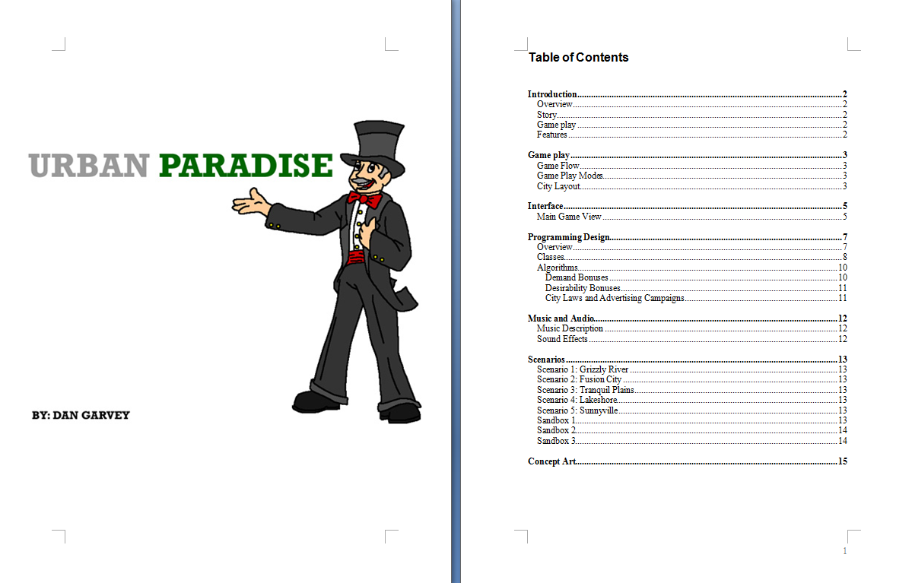
Sample

Slide 5
